Slide 1


Slide 2
GUI Implementation in LabVIEW
Damien Gray, Ph.D.
Senior Software Engineer
Instruments R&D - National Instruments

Slide 3
How to Make a Successful Large LabVIEW GUI Application
Plan
Design GUI around the problem
Use object-oriented techniques to modularize your code
Keep your code clean
Use proven program structures
Document your code as you write it
Rewrite code any time it needs it
Use source code control

Slide 4
Case Study – Shakespearean Insults Generator (SIG) - Planning
What is it?
What should the GUI look like?
What programming structures do we need to implement the GUI?
What objects/modules do we need to implement the GUI?
Notes:
The Shakespearean insults generator is a common teaching aid given to high school students. The data consists of three columns of text derived from Shakespeare’s plays. The generator randomly selects a text string from each of the three columns, prepends the word “Thou” and prints the result. An internet search on “Shakespearean insults” or “canker-blossom” will locate several versions of the text.
The basic GUI needs a results string and a button to generate a new insult.

Slide 5
Object Oriented Design
Key to object oriented design is objects; objects have methods and data
Methods are VIs which pertain to the data
Data is a globally available, encapsulated, lockable database
  Many ways in LabVIEW to make this type of database
  Recommended way: shift registers
Creation and destruction VIs initialize and close the databases, respectively
Notes:
Object-oriented design is key to good GUI program development. It allows scalable, easy-to-maintain program structure. LabVIEW is not inherently object-oriented, but that should not prevent you from using it in an object-oriented fashion.
Methods are simply VIs which operate on your data. Most of the methods will be simple “get” and “set” methods. You should interact with the core data of an object only with the object’s methods. This is a matter of programming discipline, not language imperative, as it is in C++.
Databases are a whole topic in themselves. Possible LabVIEW database methods are GOOP (old or new), front panel controls, datasocket connections, and shift registers. Of this group, shift registers (and new GOOP, since it uses them) is the fastest and easiest to customize. Old GOOP is a good idea, but has a factor of 20 performance hit because of going through the UI thread. Front panel controls have the same problem. New GOOP, from Endevo, is nice, but not free. It also includes inheritance. Datasockets are interesting because they are a networked database. However, they are slow since they go through the datasockets interface.

Slide 6
Objects of SIG
Insult Database
Main
Utility
Notes:
This is a simple application, so it has three objects – main, insult database, and utilities. Neither main nor utility are full objects, since they only have functions, not data. In a complex application, main will be a full object and will contain bookkeeping information.

Slide 7

Keep It Organized
Disk structure should mirror object structure
VI names should be prefixed with project and object acronyms
VI icons should show root object, object, and subject
  Keep icons up-to-date
  Use consistent images
  Example – Scope-SFP write configuration to disk
Notes:
On the icon, the border identifies it as an NI soft front panel. The top panel identifies it as coming from the Scope-SFP. The wrench indicates a configuration. The 3D cylinder symbolizes a hard drive. The text shows the file format is HDF5.

Slide 8
File Structure of SIG
Each object has a directory
Each directory is divided into methods and data
  main directory contains repository (database)
  methods directory contains VIs
  data directory contains database strict typedef(s)
  controls contains general purpose controls

Slide 9


Icon Structure of SIG
Color choice (parchment like) indicates SIG
Databases indicated with disk objects
Creation and destruction use standard glyphs
Notes:
Example icons are the creation and destruction icons for the insult database. It is worth your while to maintain a glyph database you can use to rapidly construct icons. Most bitmap editors (and Windows XP) have a way to browse a directory of graphics. Create this in a way it is easy for you to use.

Slide 10
Basic Engine for GUI Applications
Need event handler and task handler
May need one or more process loops
  Should be able to abort any process loops at any time
May need state machine
Use functional global databases for data encapsulation
Notes:
The basic functionality needed is an event handler and task handler. The event handler sends tasks to the task handler. A good GUI based application has two or more ways to do almost any task. Separating the processing of the events and tasks allows you to maintain this easily. For example, to close a Windows®-based application, the user may press Alt-F4, select File->Close, press Alt-F-X, or click the close button. Each of these is a separate event, but the task is the same.

Slide 11
SIG Engine
Simple event handler and task handler
Easy to add more modules

Slide 12
Refactoring
Efficiency
Maintainability
New LabVIEW features
Bug fixes

Slide 13
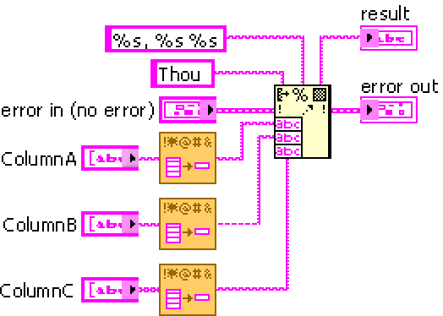
Refactoring in SIG
Look at combination function
  Original was much larger
  Refactored by creating subVIs
Notes:
If you see complex pieces of code appearing in your code in more than one location, it is time to refactor. Use the create subVI feature of LabVIEW to make this easier. You should never copy a large piece of code and paste it into another location. This produces maintenance problems. Create subVIs. This applies even more in the last three weeks before you release code. Dropping your coding standards when you are trying to release usually slows you down in the long term.

Slide 14
Source Code Control
Protect the investment of your time
Allow easy “rewind” in case of problems
Allow others to access your code
Provide timestamping
USE IT!
Notes:
Source code control in LabVIEW is a problem because LabVIEW code is binary. As such the merge features of most source code control systems do not work. You can work around this problem by always locking your code when you check it out. Good modularization of the code also allows multiple programmers to work on it at the same time.

Slide 15
Demo

Slide 16
Wrap Up
Plan
Design GUI around the problem
Use object oriented techniques to modularize your code
Keep your code clean
Use proven program structures
Document your code as you write it
Rewrite code any time it needs it
Use source code control

Slide 17
Resources
DevZone
OpenG Project (http://www.openg.org) - web site dedicated to expanding LabVIEW in an open source manner
LabVIEW Technical Resource (http://www.ltrpub.com/) – magazine dedicated to LabVIEW
LabVIEW Web Ring (http://www.webring.org/cgi-bin/webring?ring=labview;list) – webring dedicated to LabVIEW. Links and data are sometimes a bit old.
Google

